Slide 1
A Graphical Operator Framework for Signature Detection in Hyperspectral Imagery
David Messinger, Ph.D.
Digital Imaging and Remote Sensing Laboratory
Chester F. Carlson Center for Imaging Science
Rochester Institute of Technology

Slide 2
What is Spectral Imaging?
Over time (passive) imaging systems have improved their spectral response and sensitivity
  B&W (1 spectral band)
  Color (RGB, 3 spectral bands)
  “Multispectral” (5 - 12 spectral bands, e.g., Landsat)
  “Hyperspectral” (~100s of spectral bands)
    “reflective” regime and “emissive” regime
Why more bands?
  more spectral information leads to greater material separability

Slide 3
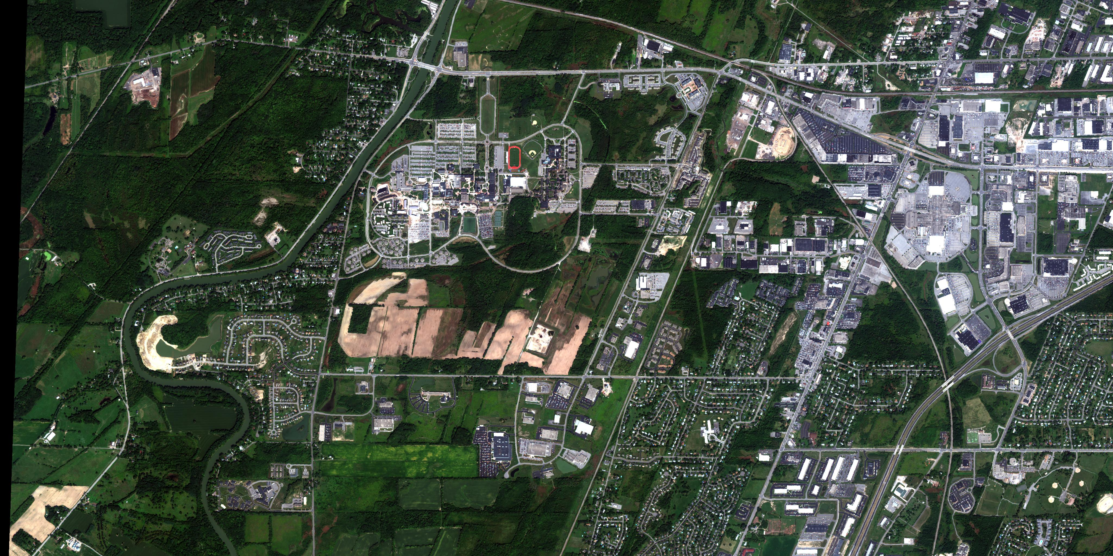
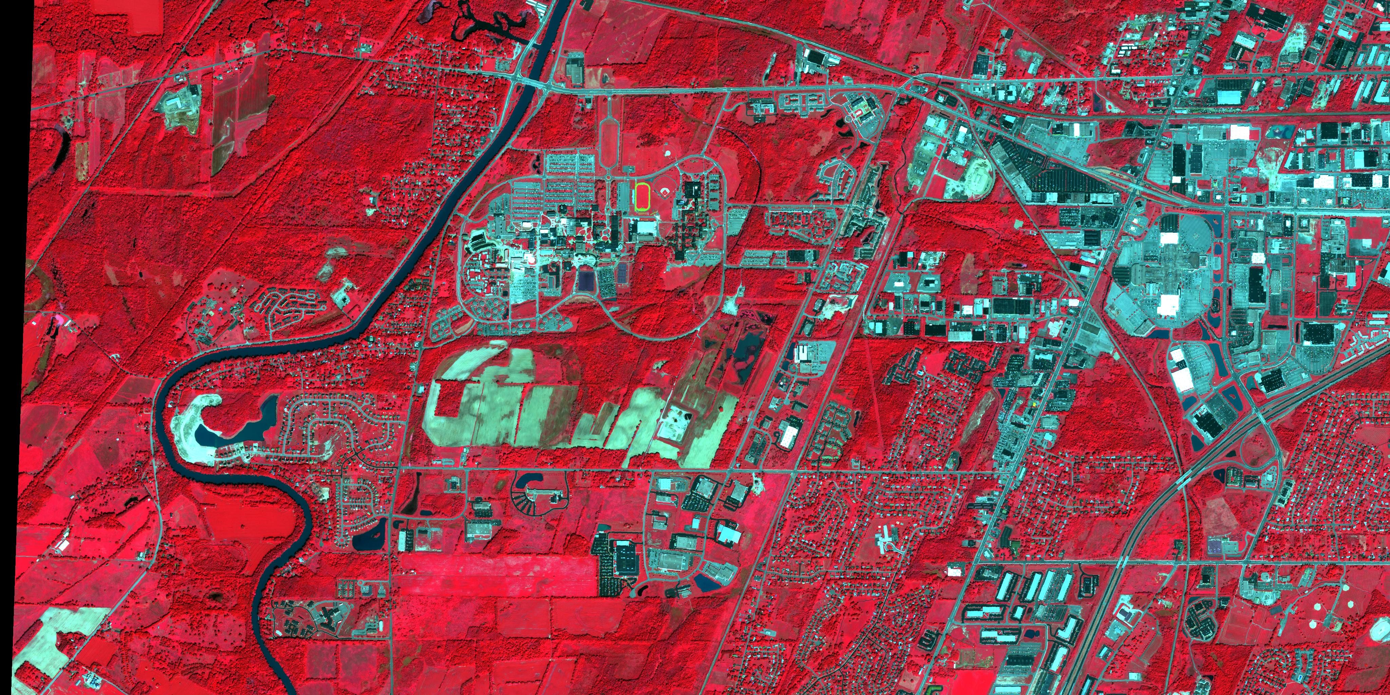
Example: Worldview-2, 2m GSD, 8 bands
Color Infrared multispectral used to assess vegetation health
image courtesy of DigitalGlobe

Slide 4
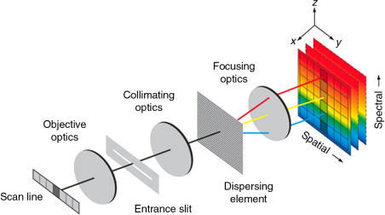
Basic Imaging Spectrometer System
Example “pushbroom” camera
Scan line is “pushed” forward by aircraft / satellite motion
Image is collected one line at a time, but full spectral information is collected for each line on 2D array
Other system designs as well that use 1D arrays, whiskbroom collection approaches, etc.
2D detector array
1D collection aperture

Slide 5
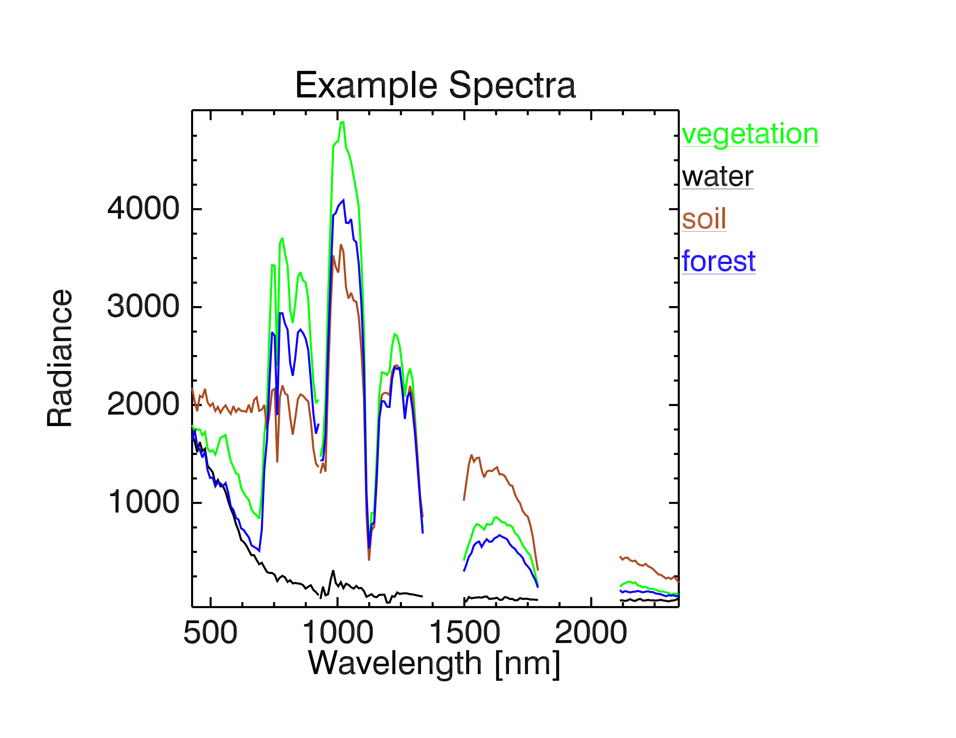
Material Specific Spectral Responses
includes atmospheric effects due to water vapor, gas constituents, aerosols, etc.
collected with the NASA Hyperion hyperspectral sensor on board EO-1 satellite.

Slide 6
Typical Applications
Vegetation analysis
  keys off specific spectral features related to health of vegetation
Mineral analysis
  keys off specific spectral features due to mineral structure
  primary region of interest is in SWIR (1-2.5 μm)
Detection
  change / anomaly / target
Classification
For these tasks we need a mathematical model of the data to build algorithms with

Slide 7
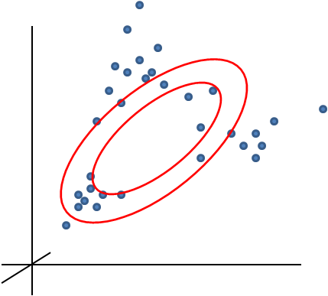
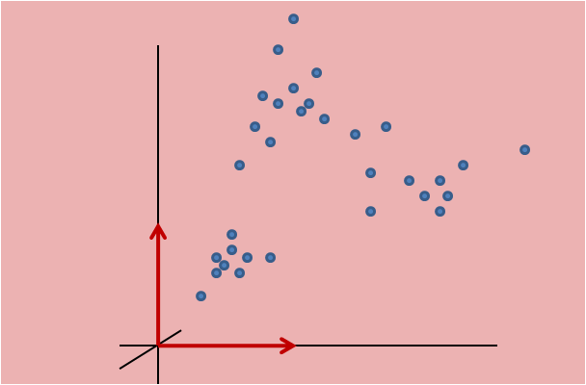
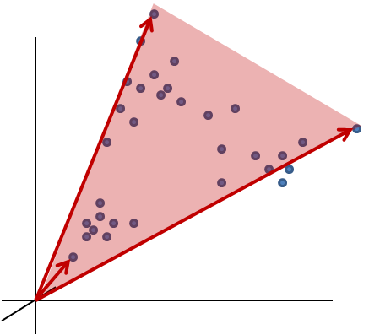
Data Models Used in Algorithms
Traditional Spectral Data Models:
Assumptions of linearity or multivariate normality.
Statistical Model
Vector Subspace Model
(Basis set is orthogonal)
Linear Mixture Model
i.e., Convex Hull Geometry
(Basis set is not necessarily orthogonal)

Slide 8
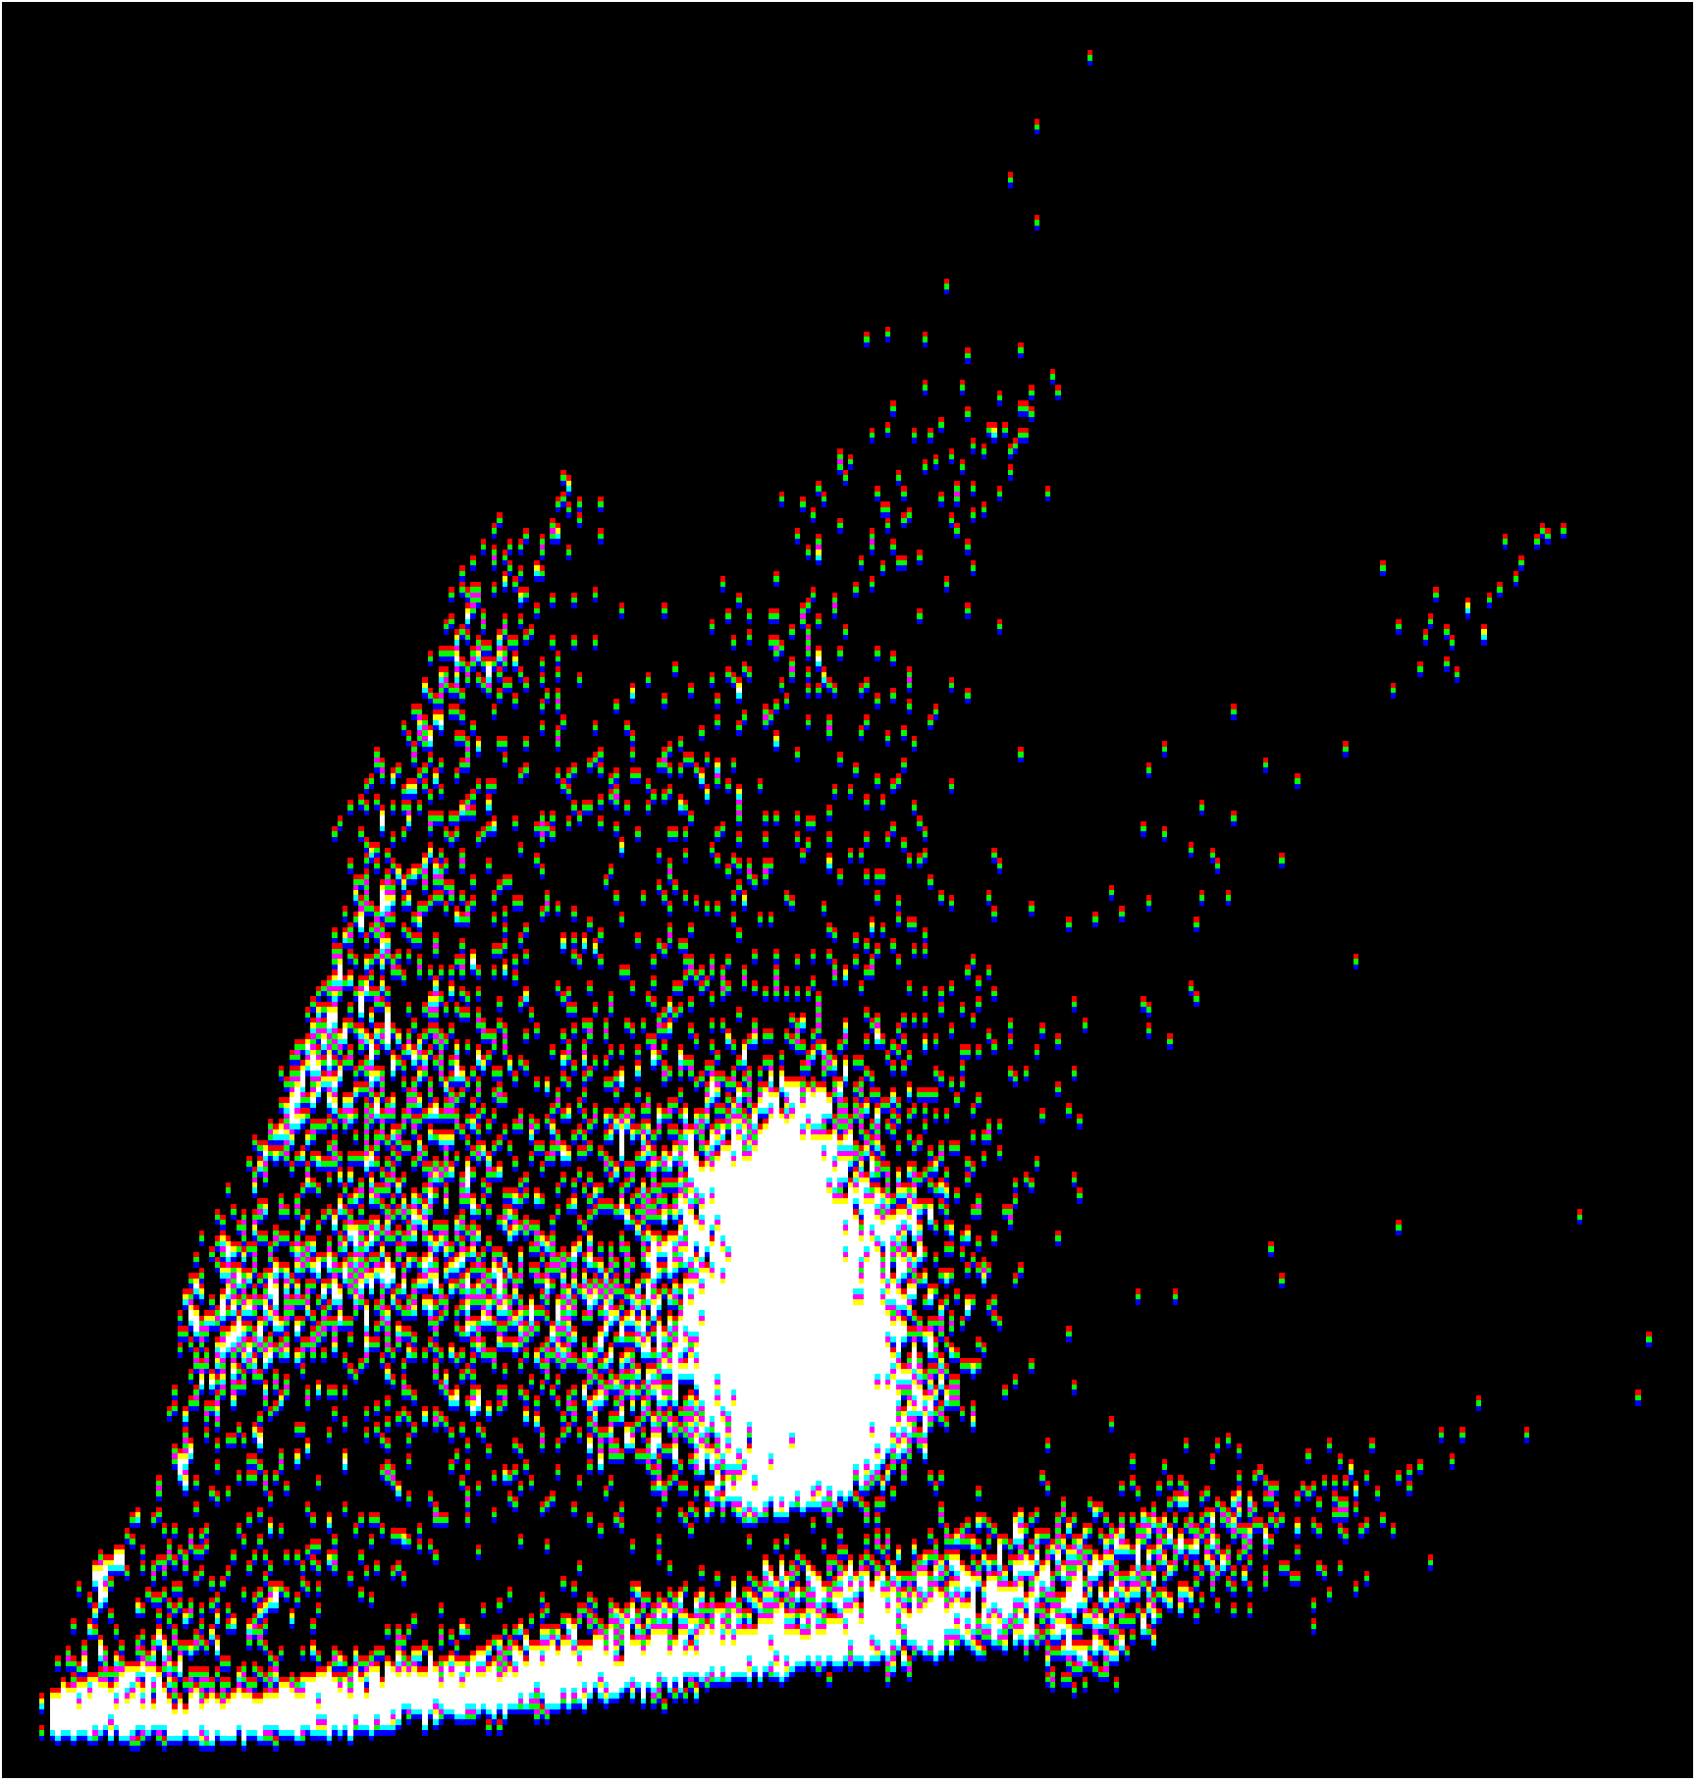
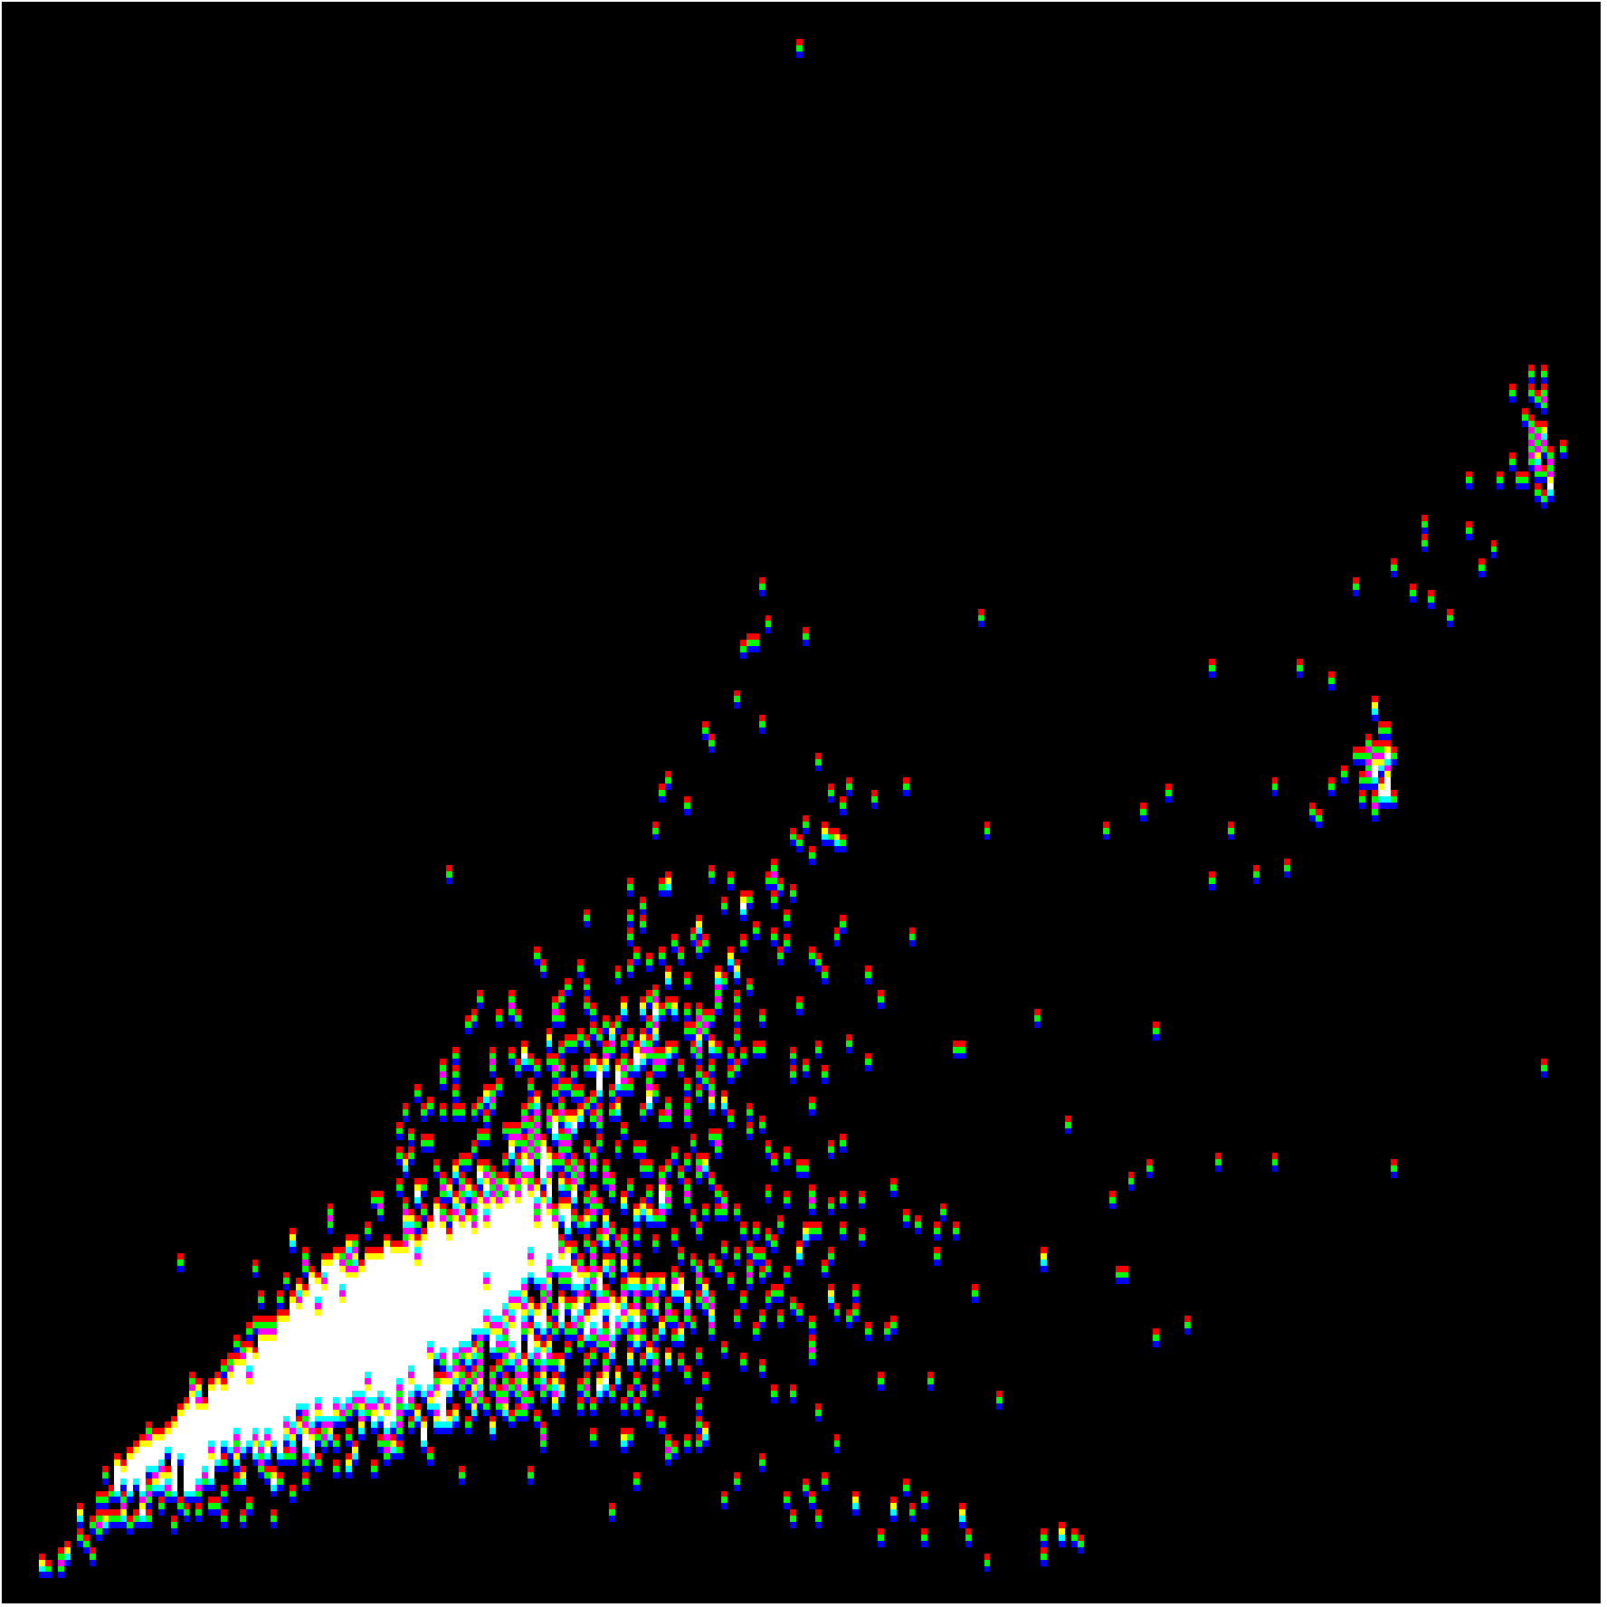
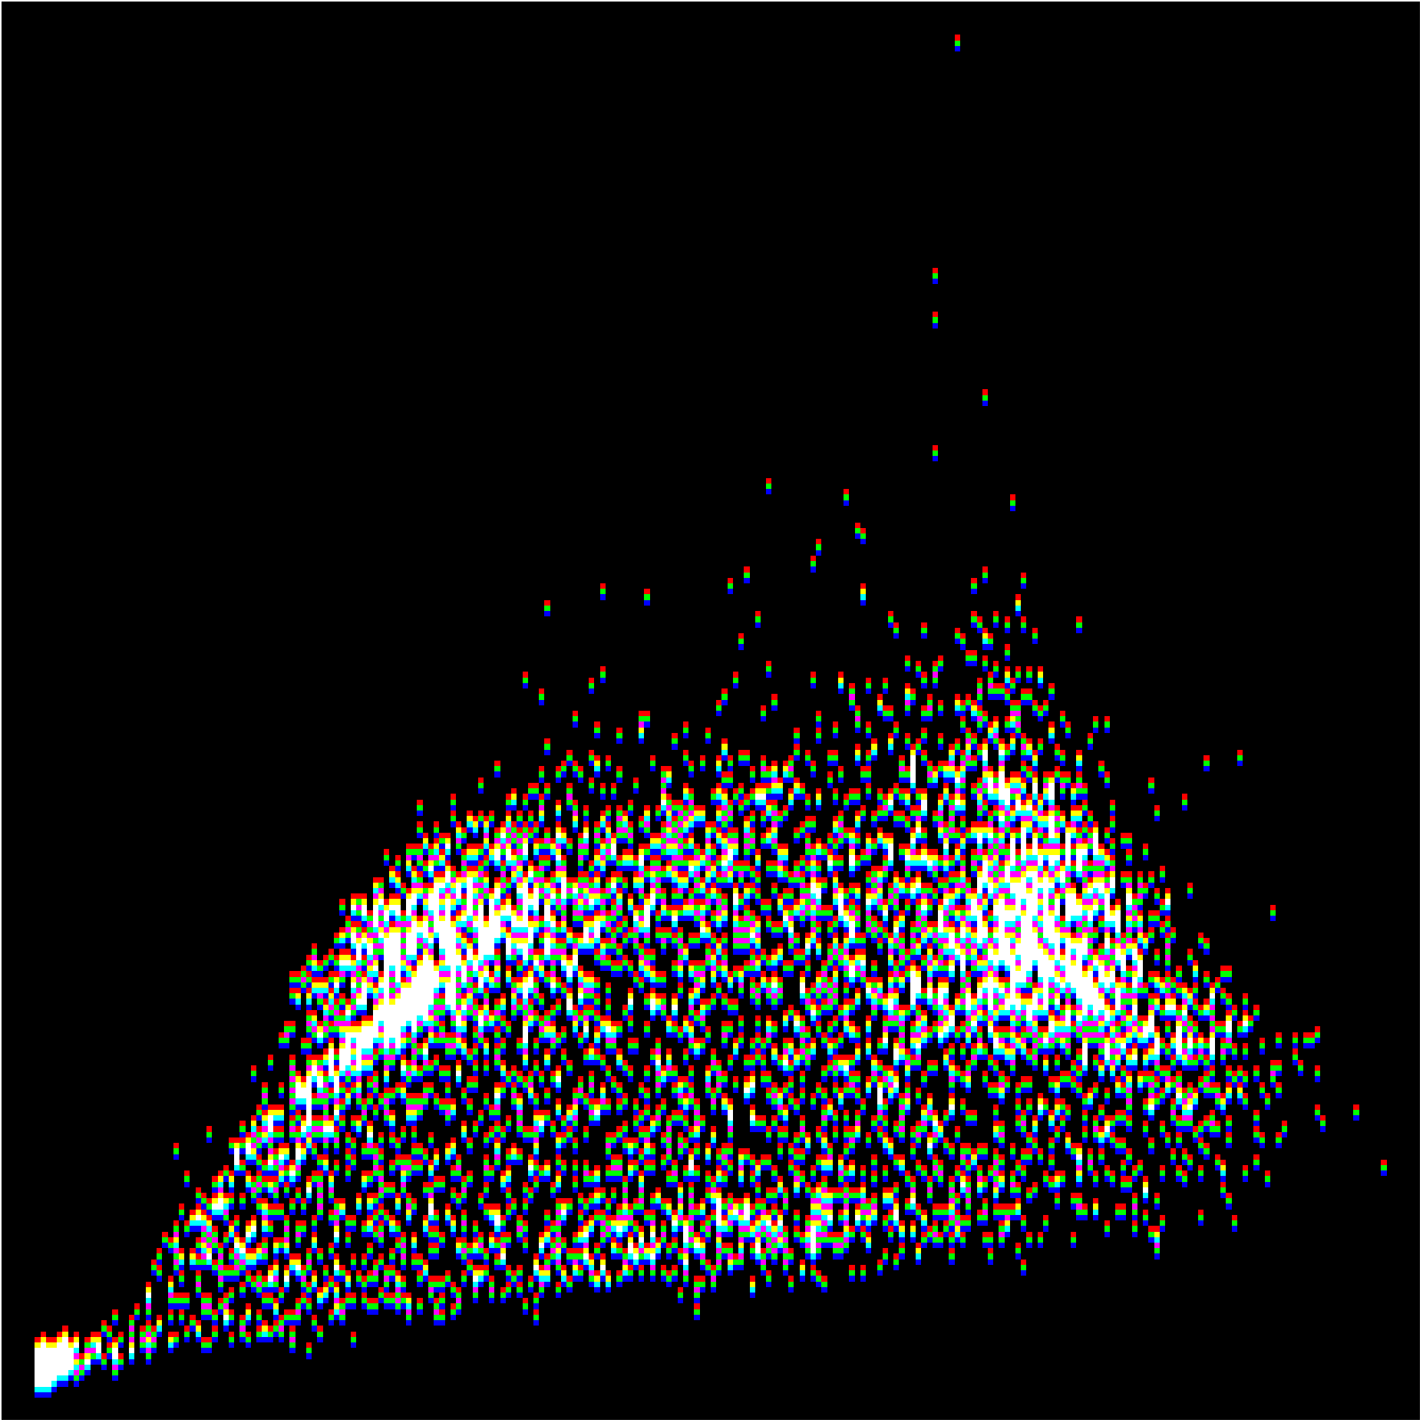
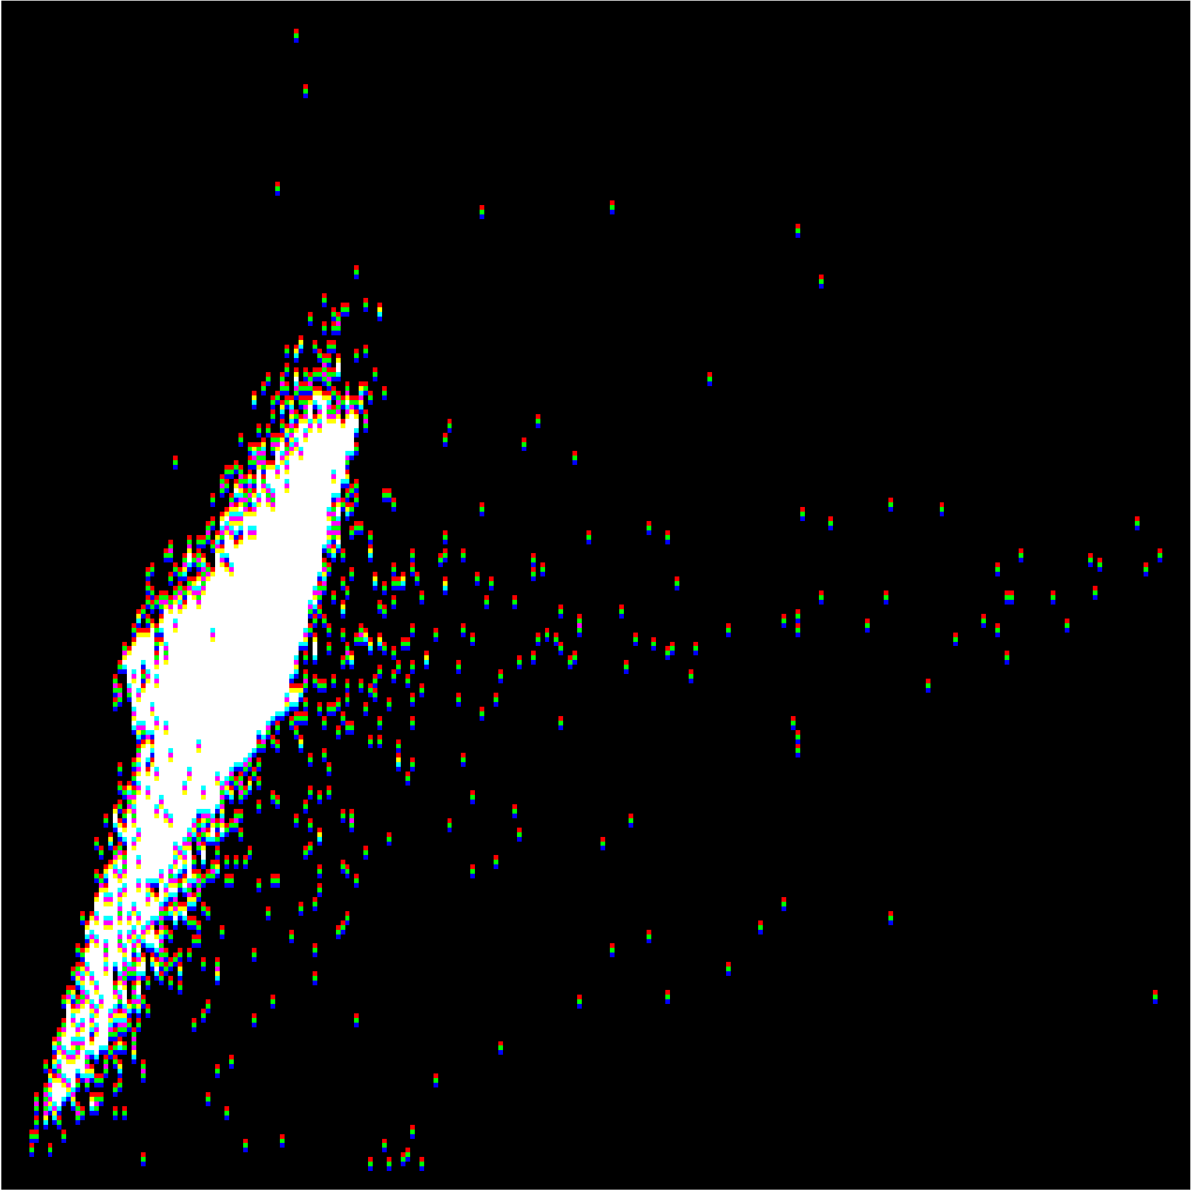
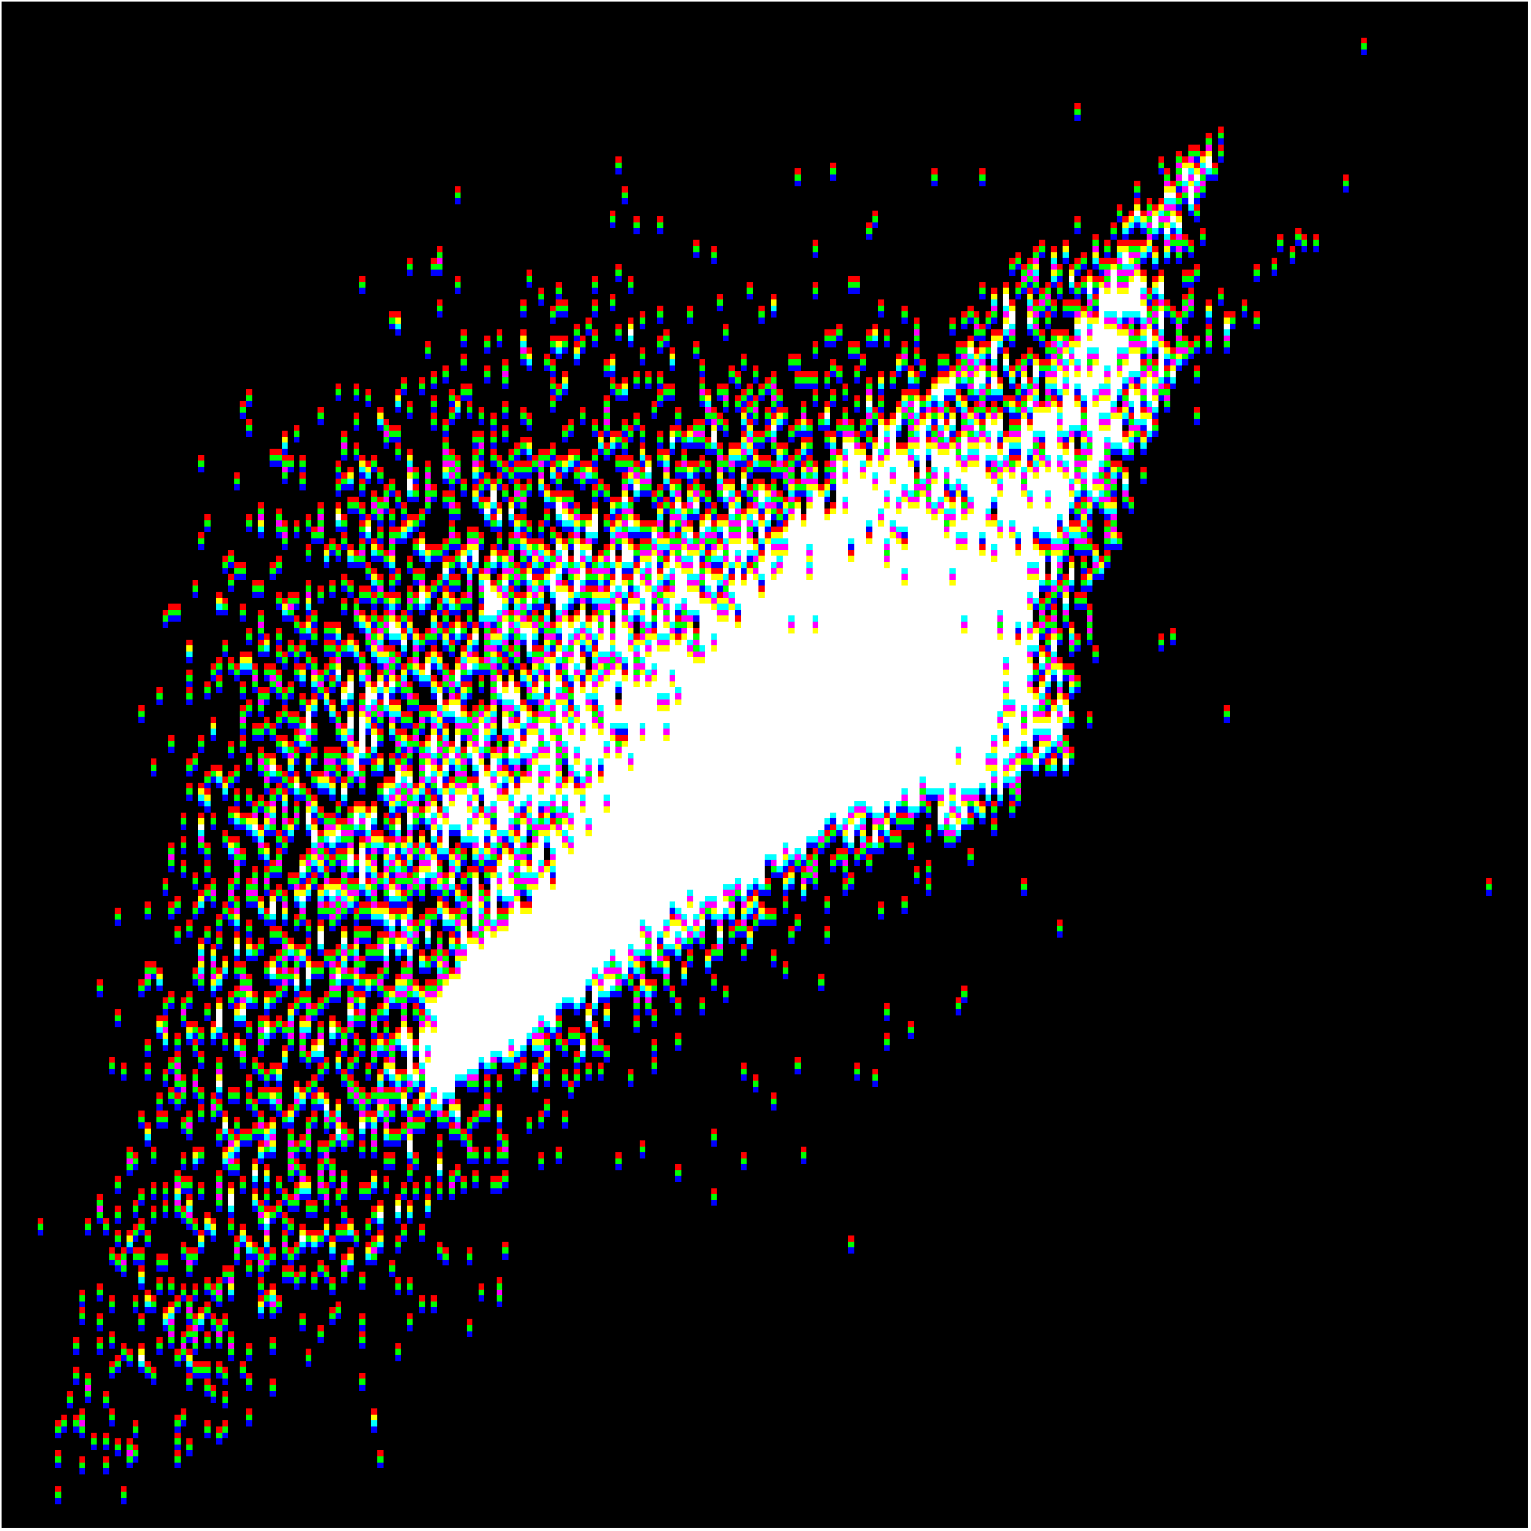
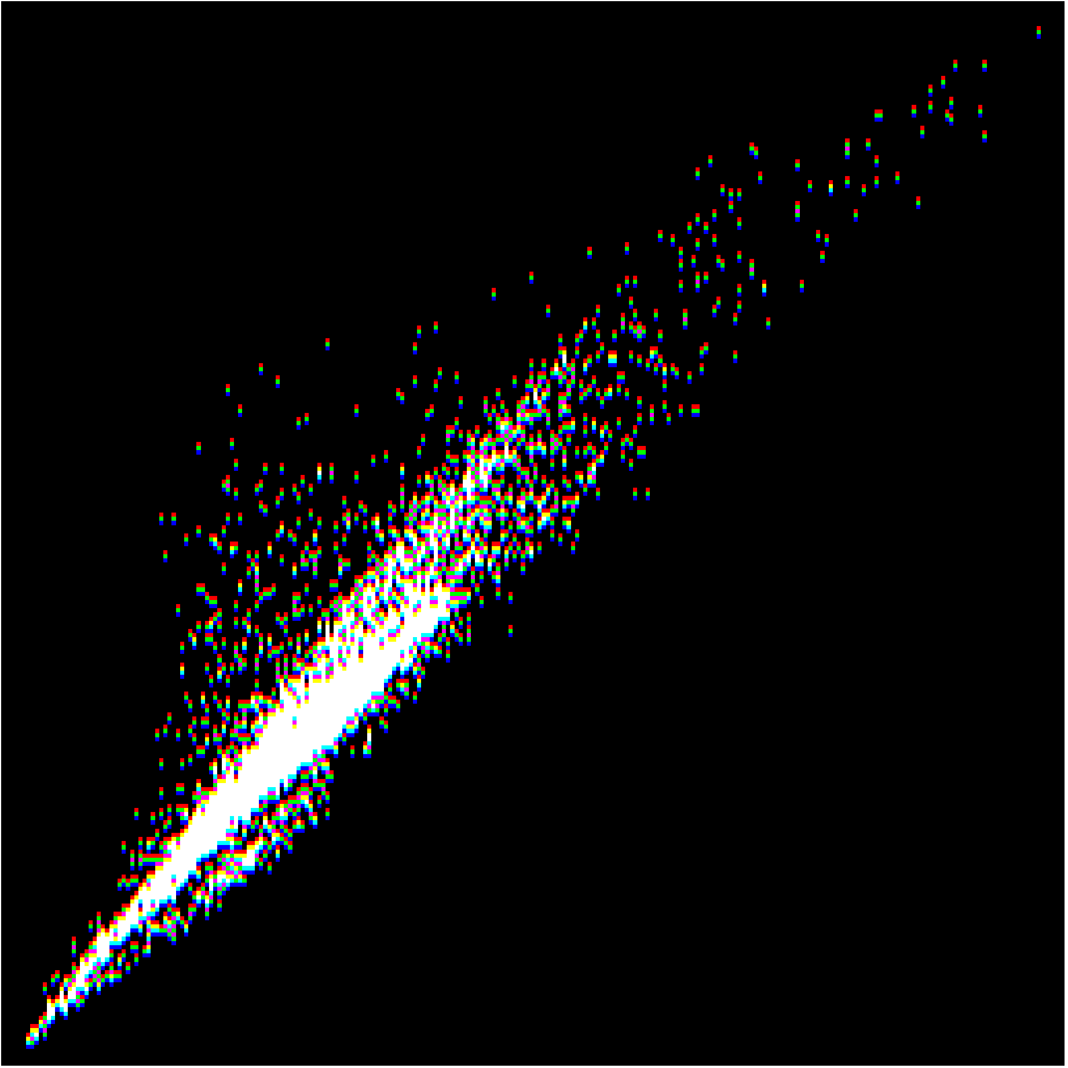
2D Projections of HSI Distributions
image courtesy of Dr. Ron Resmini

Slide 9
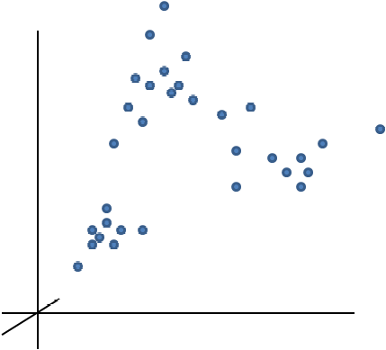
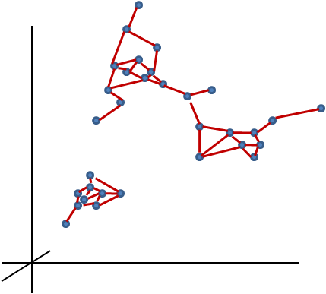
New Data Model: Graph Theory
Traditional Spectral Data Models:
Assumptions of linearity or normality.
Statistical Model
Vector Subspace Model
Linear Mixture Model
(Basis set is orthogonal)
(Basis set is not necessarily orthogonal)
Graph-Based Spectral Data Model:
No geometric or statistical assumptions, based on the “structure” of the data
Spectral Data
Graph-Based Model

Slide 10
Building the Graph: How do I create the edges?
Problem: what is the sensitivity of any algorithmic task using this framework to the way we create the graph?
  we only have the nodes, not the edges......
How do we decide which edges to connect?
  kNN, adaptive kNN, Mutual kNN, etc.
How do we measure similarity?
Several approaches; depends on the end task and goal

Slide 11
Using the Graph: What Can I Do With It?
Several algorithmic approaches can be developed based on graphical representation of the data in the spectral domain
  clustering
  anomaly detection
Difficult problem: target detection
  what is the likelihood that any particular pixel contains a known signature of interest, even at small, subpixel fractions?
  generally solved with a likelihood ratio test, matched filter, etc.
How can we use a graphical model for this problem?

Slide 12
Start with Laplacian Eigenmaps
Knn Graph: Construct a k-nearest neighbor graph in the spectral domain and compute the weight matrix W:
Graph Laplacian: Calculate the Laplacian matrix
Find the mapping: Solve the Eigenproblem:

Slide 13
Schrodinger Eigenmaps
The Schrodinger equation based on Laplace equation has an additional potential term V
There are different forms to define the potential matrix
  Barrier Potential:
The mapping is given by:
Allows us to “label” some of the data with a priori information
based on work by Wojtek Czaja et al.

Slide 14
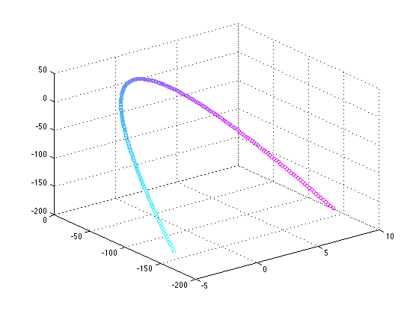
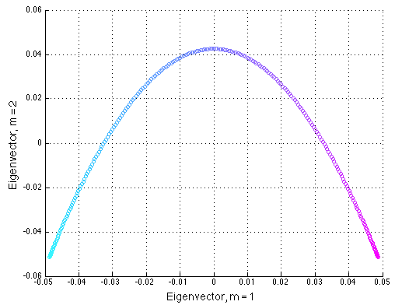
3D Data & its Laplacian Eigenmap
Laplacian Eigenmap
Original Data in 3D

Slide 15
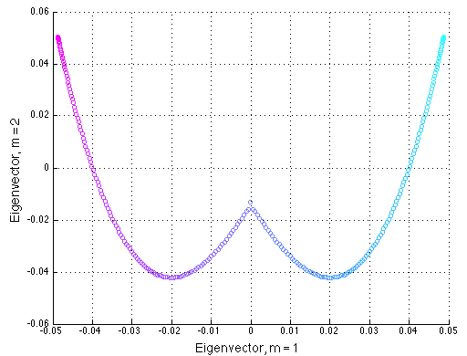
3D Data & its Schrodinger Eigenmap
Label the point at (0,0,0) in the potential V
α= 1
Original Data in 3D
Schrodinger Eigenmap

Slide 16
Clustering Approaches
Image
Create Graph
Compute L
Unsupervised clustering
LE
Add labeled data into V
Semi-supervised clustering
Create Graph
Compute L
Compute E
SE

Slide 17
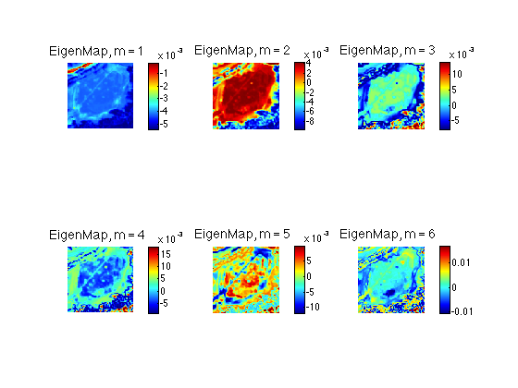
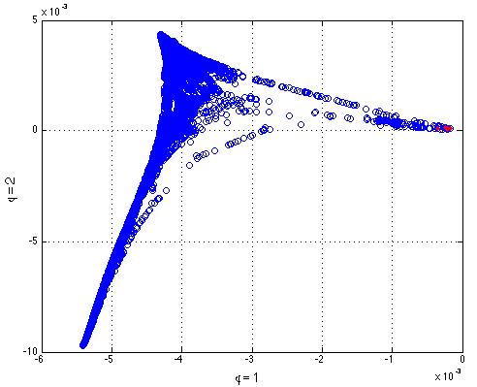
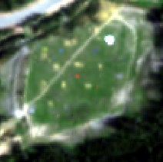
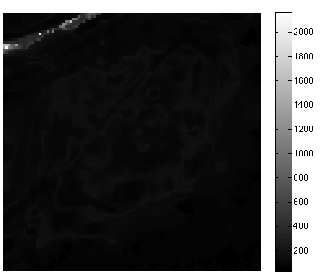
SE for Clustering
Road
several pixels on the road identified and labeled in V
note that the labeled class appears in the first component

Slide 18
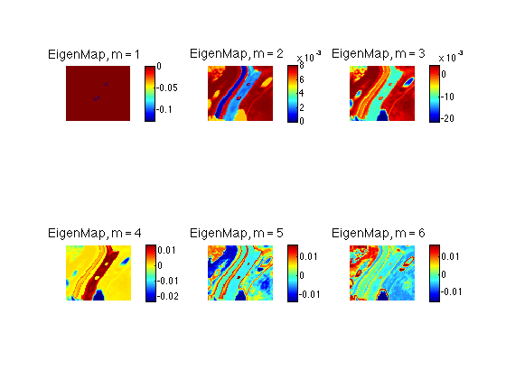
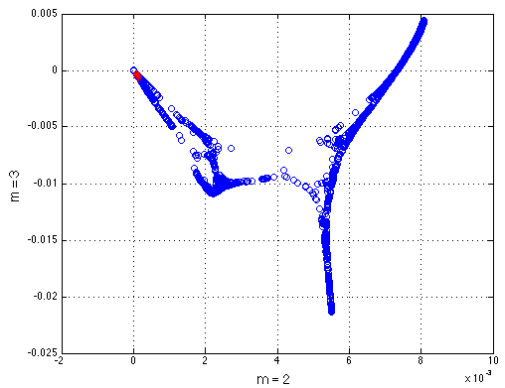
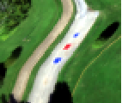
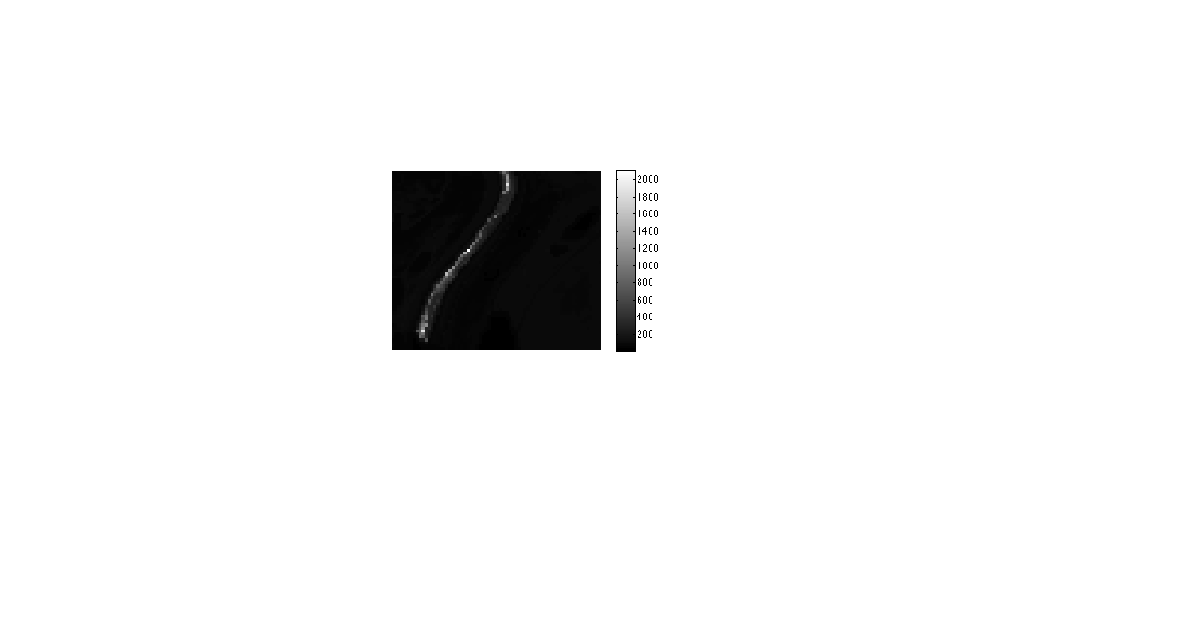
SE for Clustering
Road
several pixels on the road identified and labeled in V
note that the labeled class appears in the second component, but still pushed toward origin in new space

Slide 19
Can we use this for Target Detection?
Target detection can be thought of as a two class clustering problem, where the target class is very rare
  class 1: target
  class 2: background
But we know what we’re looking for, just not where it is in the scene
How do we move from labeling known data in the scene to labeling known data, not known to be in the scene?
  by injecting the target signature into the data set before we build the graph!

Slide 20
Target Detection Approach
Image
Create Graph
Compute L
Unsupervised clustering
LE
Add labeled data into V
Semi-supervised clustering
Create Graph
Compute L
Compute E
SE
Add labeled target data into V
Create Graph
Compute L
Compute E
Target Detection
SE

Slide 21
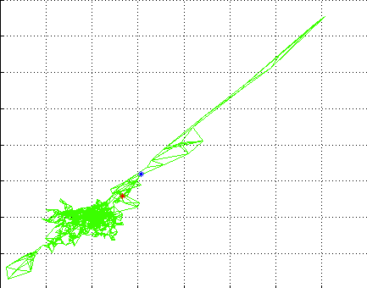
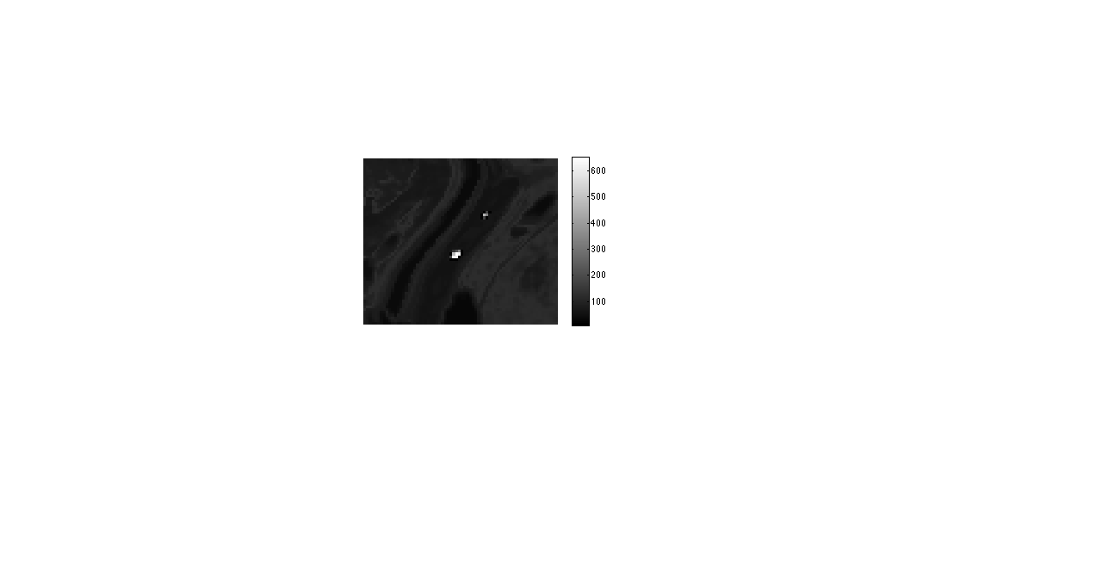
Target Detection Methodology – Detection Statistic
Schrodinger Eigenmaps results in pixels similar to labeled data being pushed toward the origin in the new space
We can use this effect as a detection statistic to identify likely targets in the SE space
Eigenvectors for pixel
pixels with high value in this statistic are deemed target-like

Slide 22
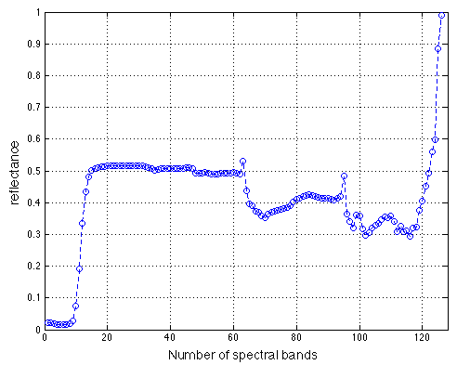
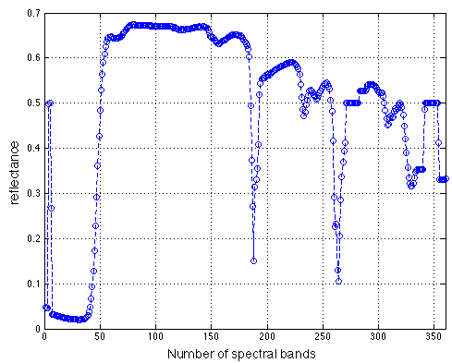
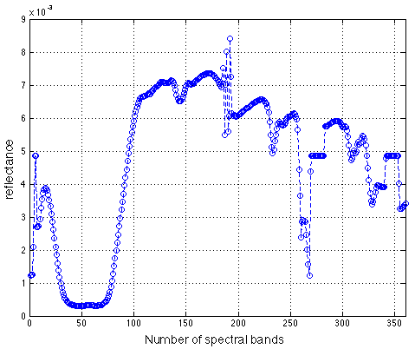
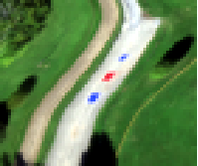
Data with Known Targets
T1
T3
T2
two hyperspectral images from two separate collections; ground truth exists for both

Slide 23
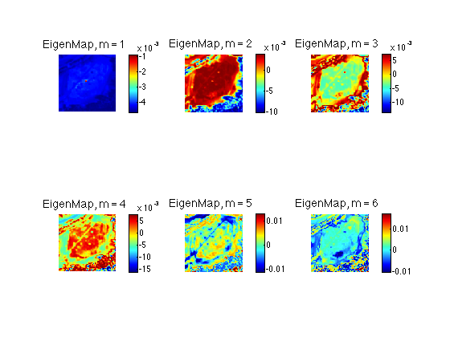
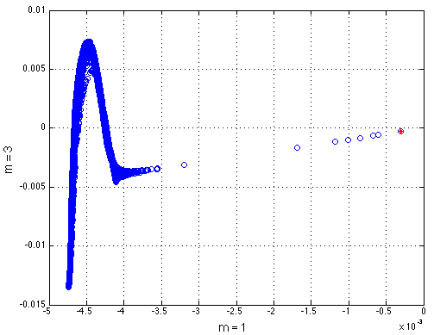
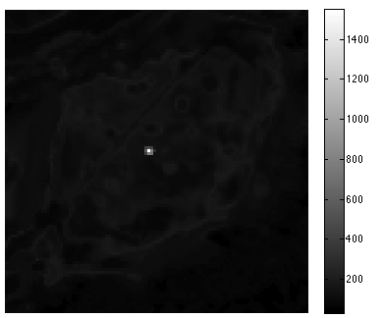
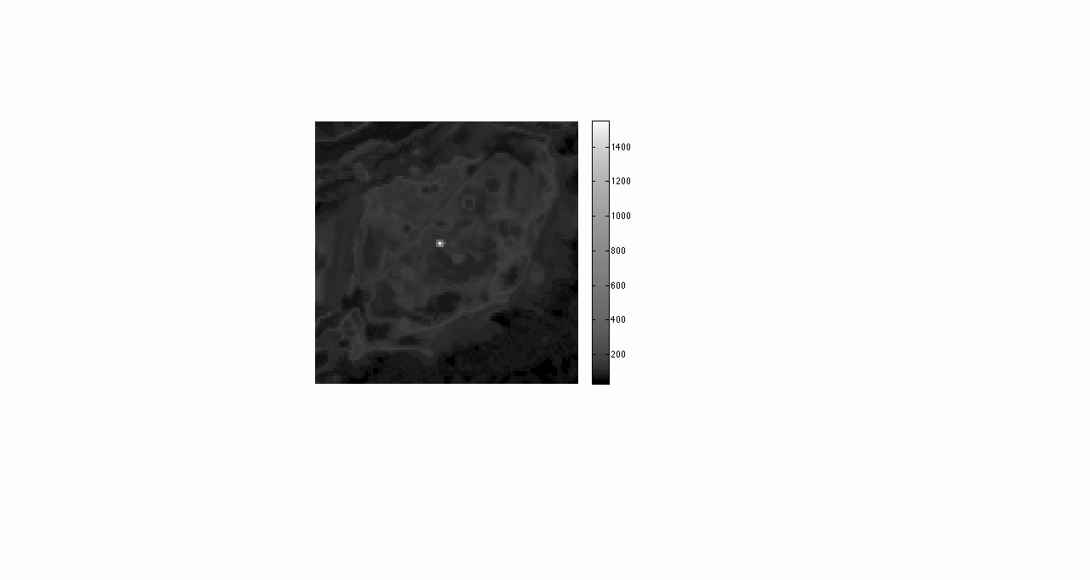
Results: In-Scene Target
Red Panel
label the spectrum of a rare pixel in the scene to see if we can find it
Image
Detection Map
Enhanced Detection Map

Slide 24
Methodology for Target Not Known to be in Scene
Laplace Matrix
Potential Matrix
labeling in-scene pixel
concatenate the known target signature onto the list of image pixels, and label the corresponding entry in V
labeling target signature

Slide 25
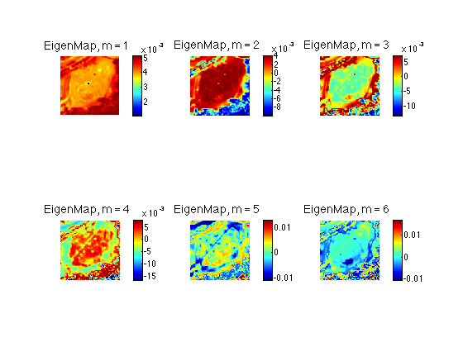
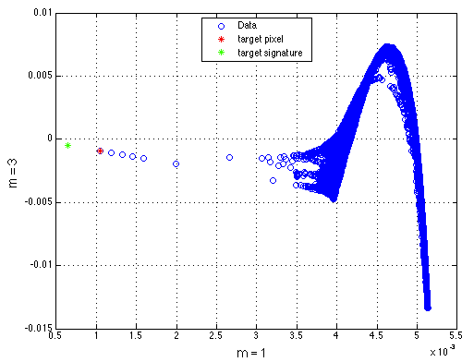

Results: Target Injected Signature
Red Panel
target signature is now a field-collected spectrum
similar pixels are pulled toward it in the SE space
Image
Detection Map

Slide 26
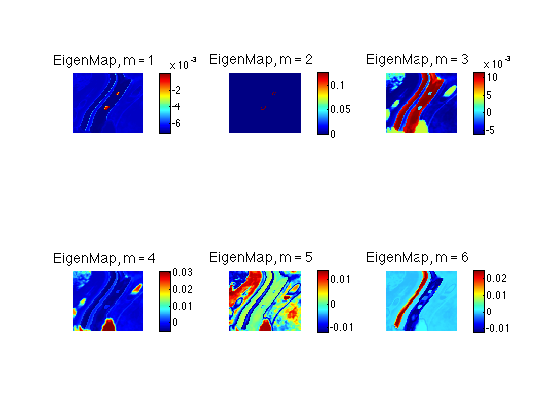
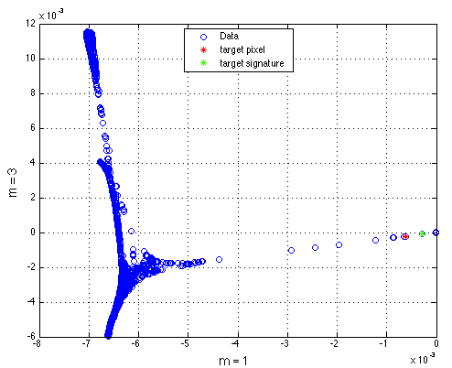
Results: Target Injected Signature
Blue Panel
note that many pixels are detected, even though only one label provided
Image
Detection Map

Slide 27
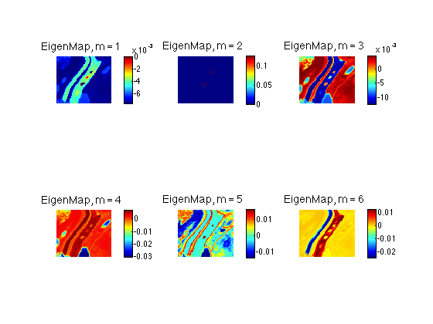
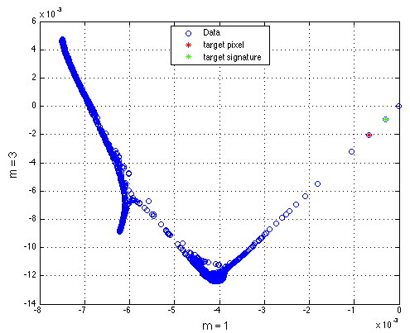

Results: Target Injected Signature
Red Panel
Image
Detection Map

Slide 28
Summary & Conclusions
As airborne & space-based imaging spectrometers improve their spatial resolution, the data become more complicated requiring advanced mathematical frameworks for analysis
We have developed several graph-based algorithms for a number of tasks:
  anomaly detection, clustering, change detection, etc.
Target detection is very difficult problem in general; difficult to formulate in graphical model
  targets are rare and can be very sub-pixel
Results are promising! Challenges still exist (computational, phenomenological, etc.)

Slide 29
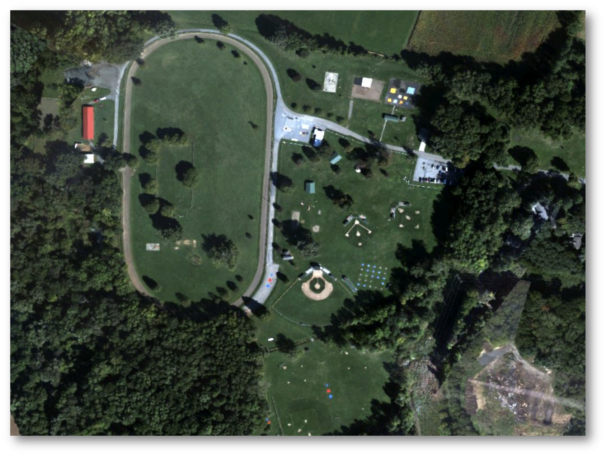
Questions?
David W. Messinger, Ph.D.
messinger@cis.rit.edu
(585) 475 – 4538
airborne image from the SHARE 2012 experimental campaign featuring over 200 targets, 4 aircraft, 3 satellites, and lots of people!

